Slide 1
Vilnius Tech Leads – The Agile One
Dominykas Punis
19-09-2019

Slide 2
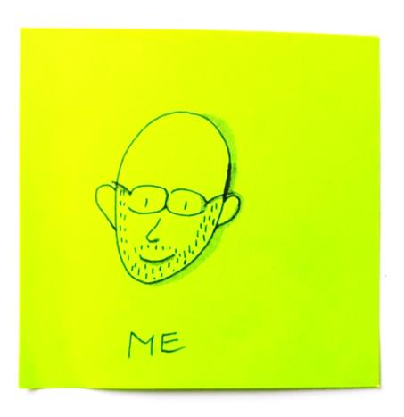

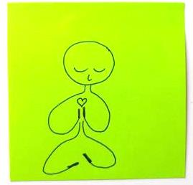








About me

Slide 3
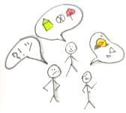
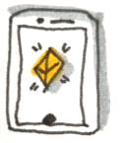
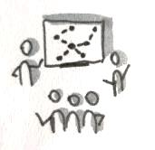
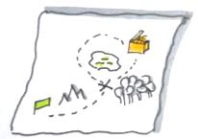
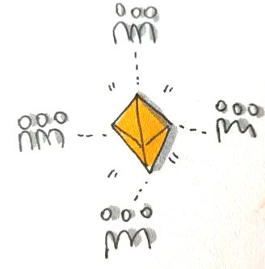
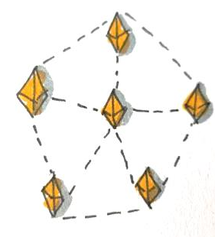
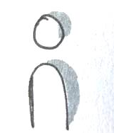
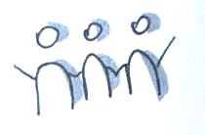
Agile
Agile Values
Individuals & interactions
Working, valuable products
Collaboration with customer
Responding to change
Agility = attribute
Individual
Team
Team of teams
Enterprise
Notes:
The topic of today is Agile. More particularly, how we understand and apply it. Mindaugas told me clearly – nobody needs a lecture, you need to speak about your experience. So I will speak about how I understood and implemented agile in my career.
Values:

Slide 4
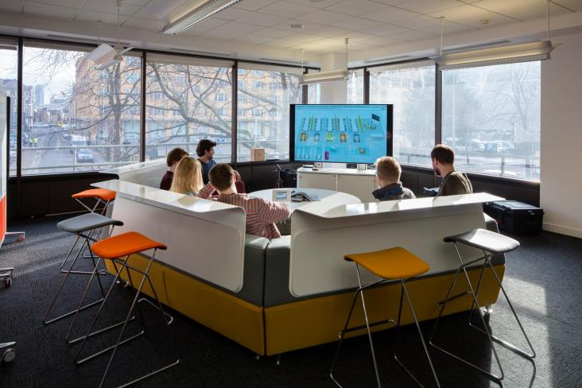
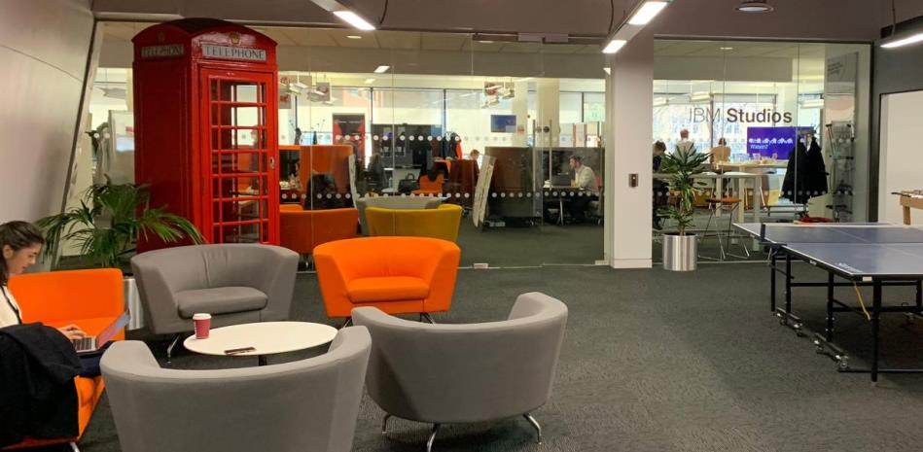
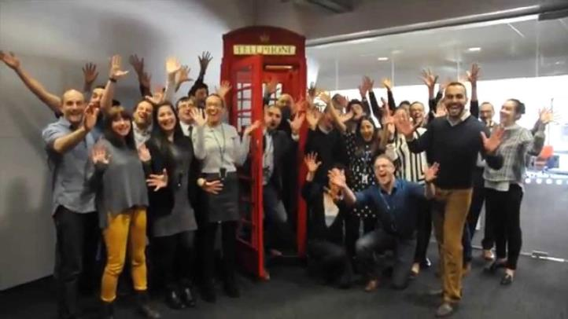
Team level – IBM iX Studio London
Notes:
Studio: building rapid development teams from UX/Graphic Designers, Full stack developers, SM and the PO (client)
As staffing manager – exploring needs, establishing teams and linking them with the client
Iterative, incremental approach connecting design thinking and agile development

Slide 5


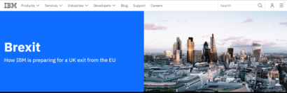
IBM Brexit site
Day of the request
Monday
Tuesday
Wednesday
Thursday
Friday
Formed a team
Paper design
Content requests
Clickable wireframe
Content discussions
Design adjustments
Content loading
Finalisation
Prep for launch
Agile values: Working, valuable products, Collaboration with customer, Responding to change
Notes:
Situation: Monday, Brexit results on Thursday, need for Brexit site by Friday. High exposure project
Forming and leading a team to create the site
Ideation workshops with PO, wireframes, site without content (waiting for industry leaders to create offerings), loading content, releasing (marketing, etc.)
Result – after finding out the negative vote, with huge regret, we launched the site and started communications

Slide 6
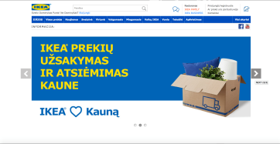
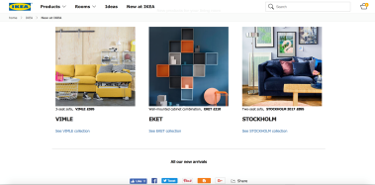
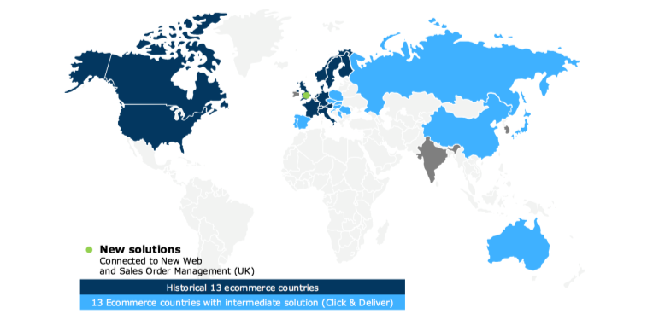
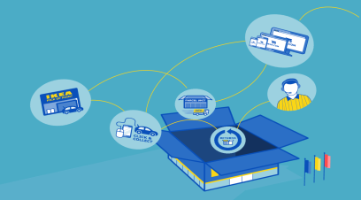

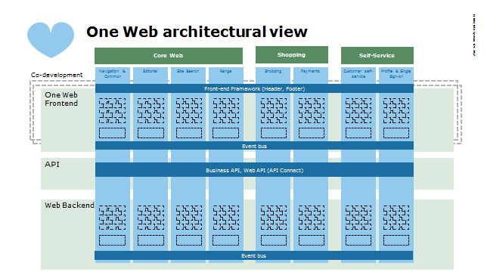
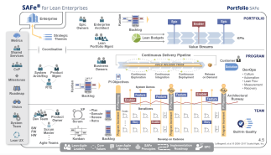
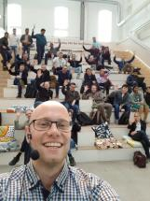
Team of teams – IKEA Multi-channel transformation
Flexible, componentized architecture (verticals)
Agile at scale approach to product development
Team self-selection
Notes:
IKEA e-commerce platform – goal
Situation: drowning program – no releases, huge bottlenecks for core components, low motivation of teams (no releases), etc. etc. etc.
Solution: establish agile architecture, implement agile framework to increase agility, self-organise into teams

Slide 7
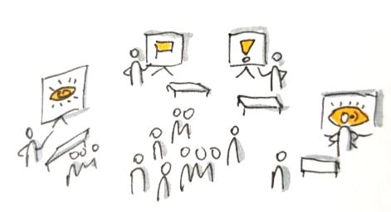

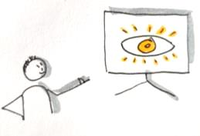
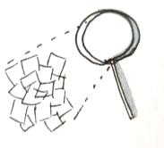

Team marketplace (Self-selection)
Team marketplace
People give preferences
POs present visions
Team announcements
Analysis and formation
Agile values: Individuals & interactions, Collaboration with customer, Responding to change
Notes:
Product owners present the vision for the verticals and competency needs for the team
Developers select the verticals they want to contribute to;
Dev. Manager evaluates overall picture
95% of developers got their 1/2nd choice
Around 50% stayed where they were
Few key people were assigned to specific teams (not everything works perfectly – transparent issue to be addressed)

Slide 8
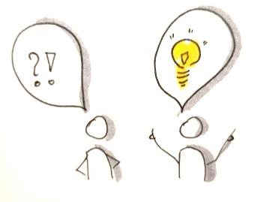
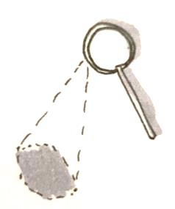
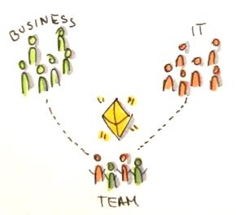
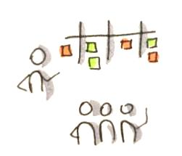
Enterprise – can it happen?
Coach individuals
(including leaders)
Organise teams around value
Grow agility of teams
Inspect & adapt
Repeat
Notes:
Can an enterprise be entirely agile? Well, yes. It’s much easier for the smaller ones, and nearly impossible for the big whales in the industry. Quite a few claim they are and those who truly are, don’t usually boast about it – they just enjoy the benefits of it.
What I’ve witnessed the most, that many companies are in this journey towards agility. And that’s perfectly fine. You eat the elephant one bite at a time. Last few years I’ve been helping them to make this journey less bumpy.
What worked from me was starting from the level one – help individuals to become agile, increase agility of the teams, organise teams around value rather than organisational silos (departments) and repeat, inspect and adapt.

Slide 9
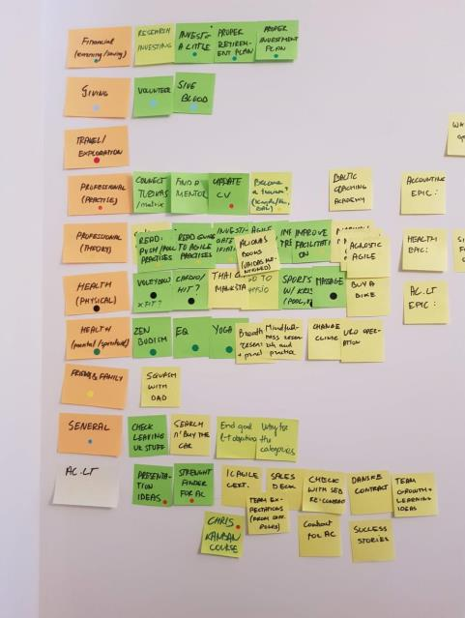
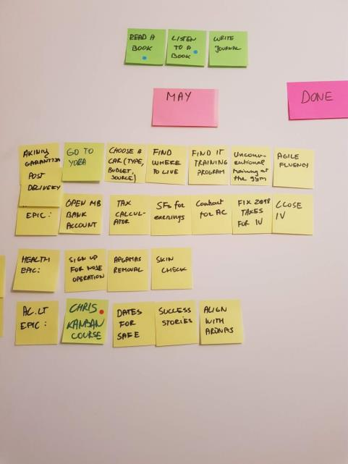
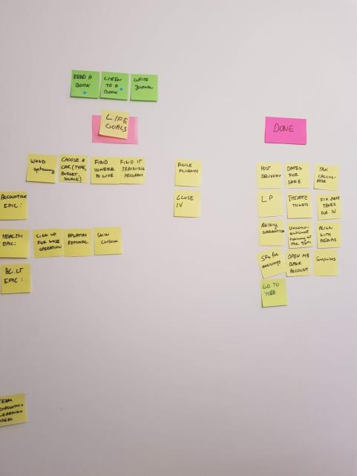
Individual level – my personal kanban
Notes:
My own practise: physical kanban board;
I’ve got different categories, priorities (based on rankings), goals for each
create tasks that contribute to them, try to focus on a single one every week
Gives transparency (always see it in front of me) & focus
Tried scrum – didn’t work (probably because I dedicated 5-10% of my time for it)

Slide 10
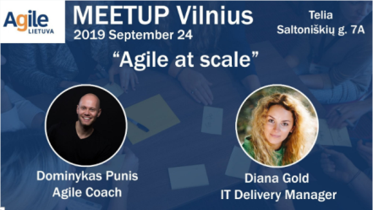

Thank you!
Join Agile Lietuva meetup next week! (24th October). Go to meetup.com/AgileLietuva/
Join my certified SAFe course on 4-5th of November at agilecoach.lt/safe
If you need help with agile – I’m available
Dominykas Punis
dominykas@agilecoach.lt

